Slide 1

WAY TO ENTERPRISE
Advanced Java
VTI ACADEMY
Author: duy.nguyenngoc1@vti.com.vn
March 2020

Slide 2
Agenda
Create/Update Form
Transaction
Validate
Internationalization
Swagger
Spring Data Rest
Assignments
Copyright © VTI Academy All Rights Reserved

Slide 3
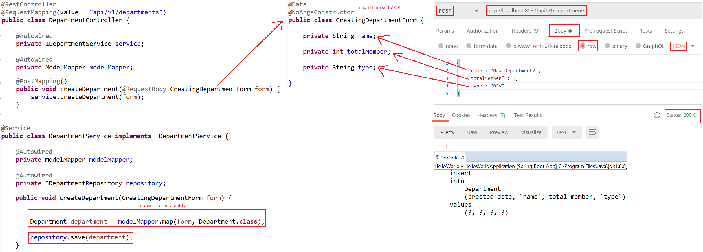
Create/Update Form
Example 1: Create & Update Form
Create

Slide 4
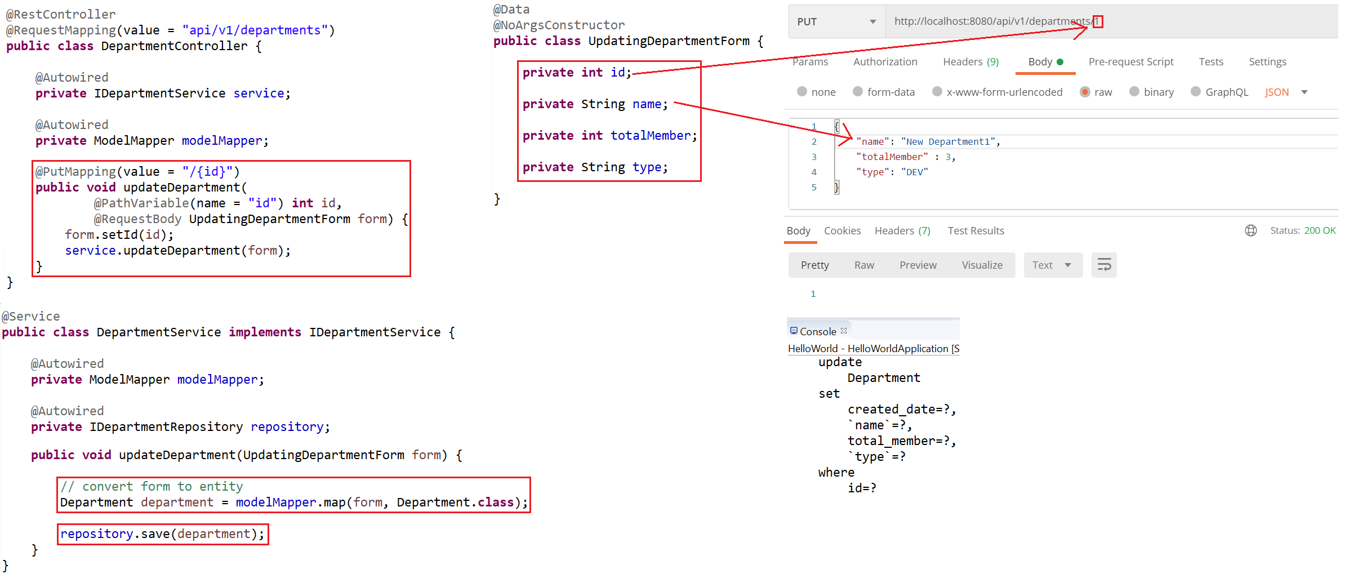
Create/Update Form
Update

Slide 5
Testing System Assignments
Self-practice

Slide 6
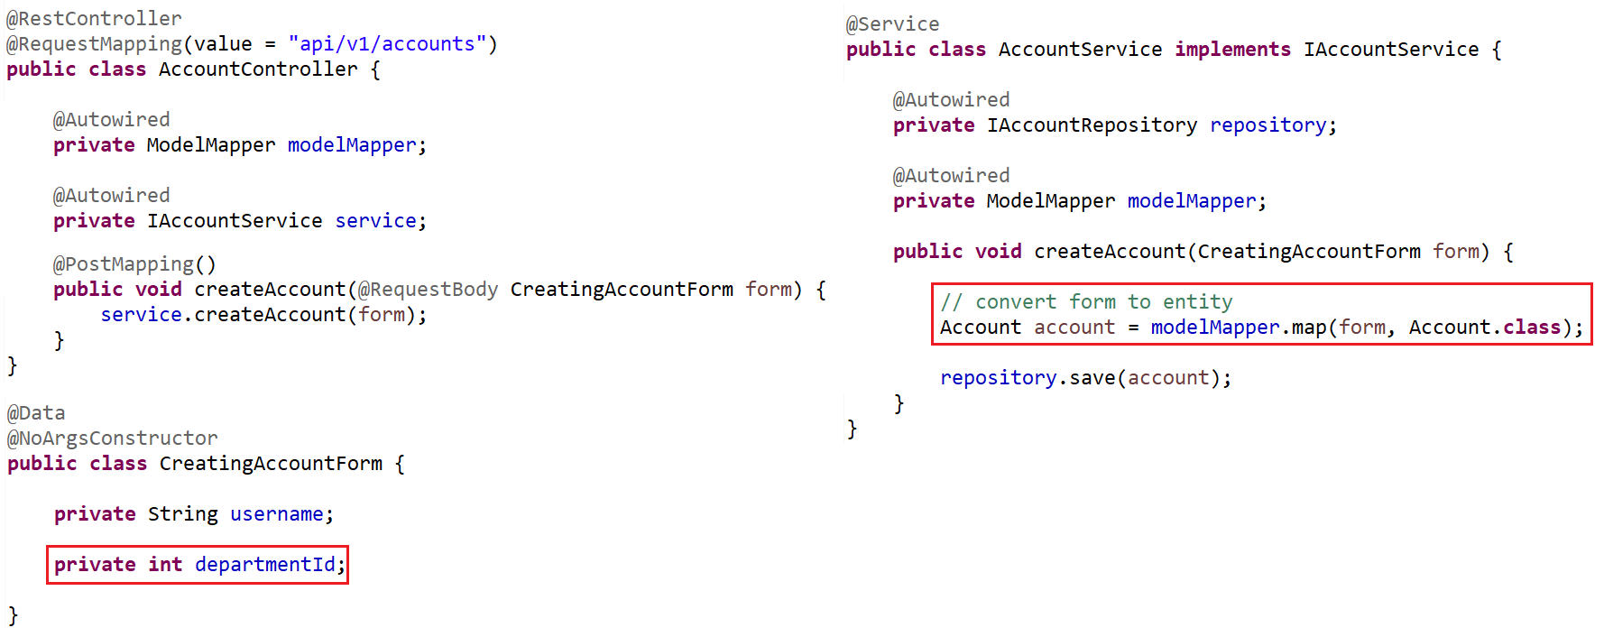
Create/Update Form
Example 2: Create Account & assign department
ModelMapper Error

Slide 7
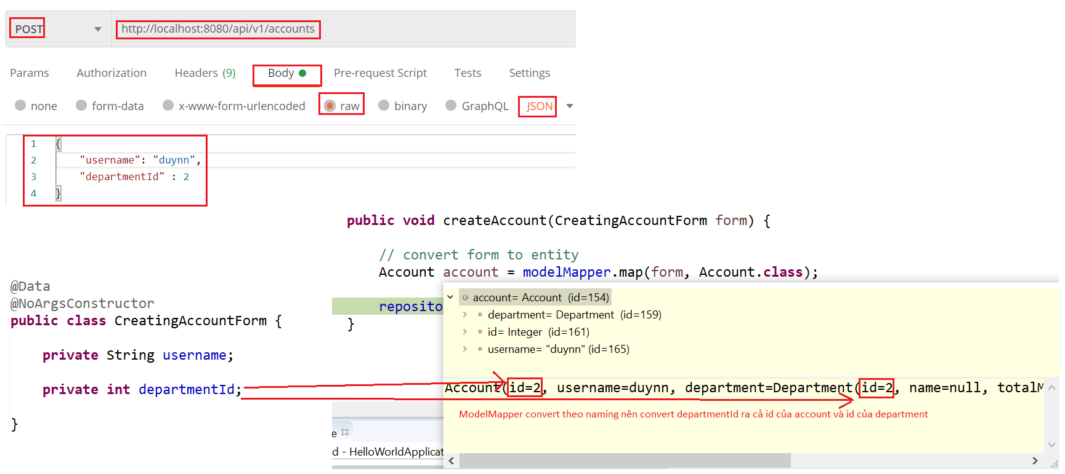
Create/Update Form
Error

Slide 8
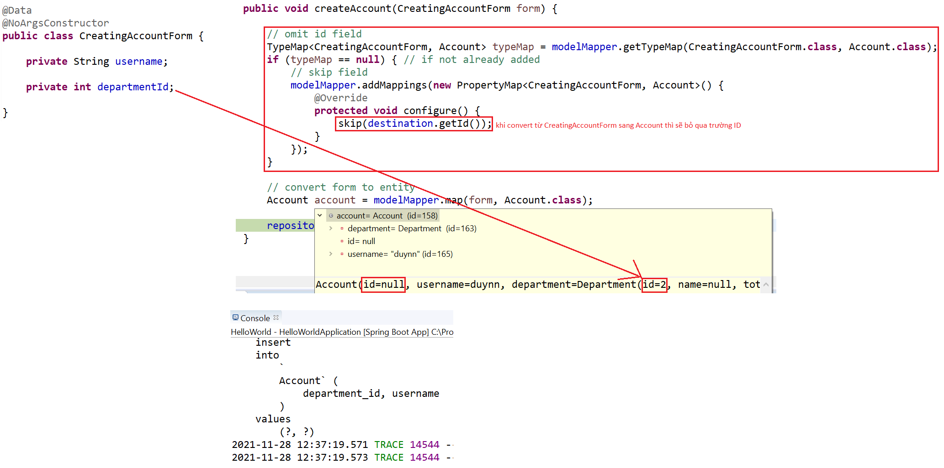
Create/Update Form
Fix

Slide 9
Testing System Assignments
Self-practice

Slide 10
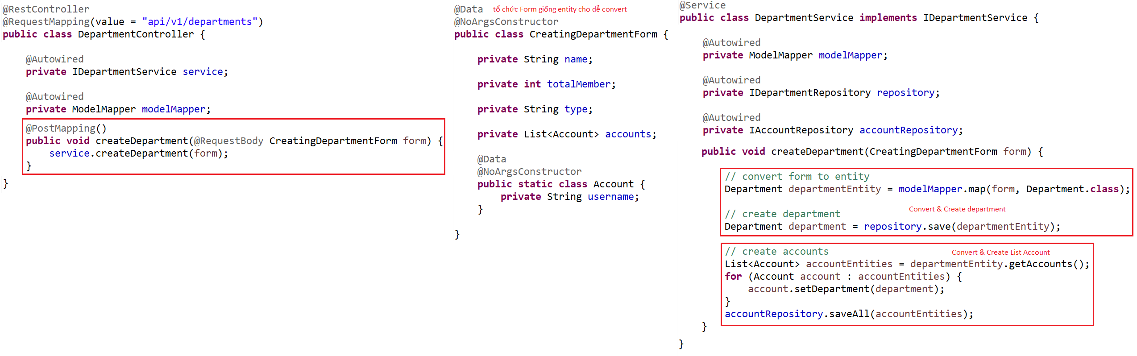
Create/Update Form
Example 3: Create Department & List Account

Slide 11
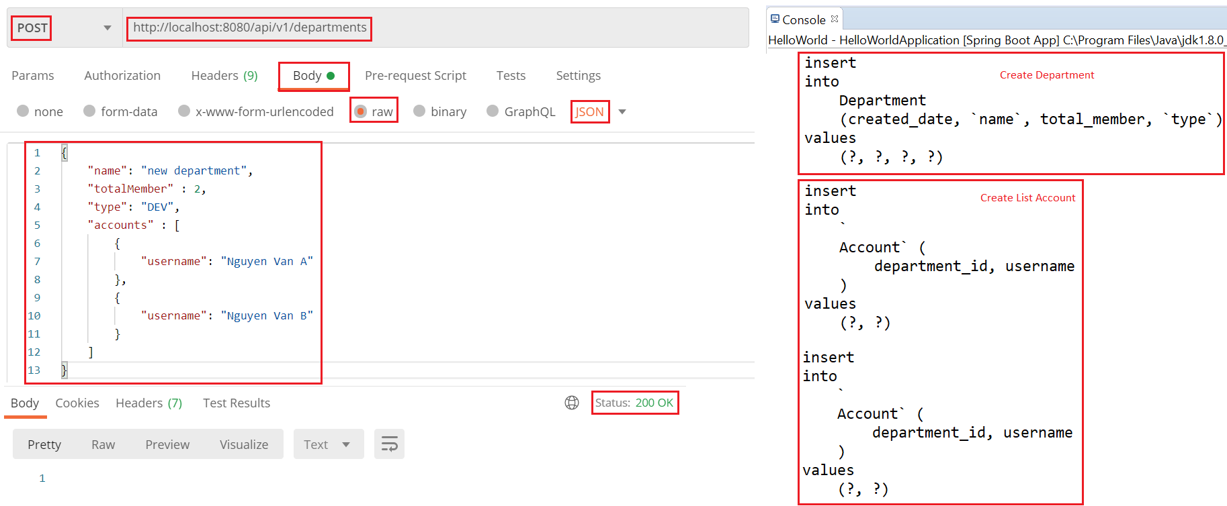
Create/Update Form

Slide 12
Testing System Assignments
Self-practice

Slide 13
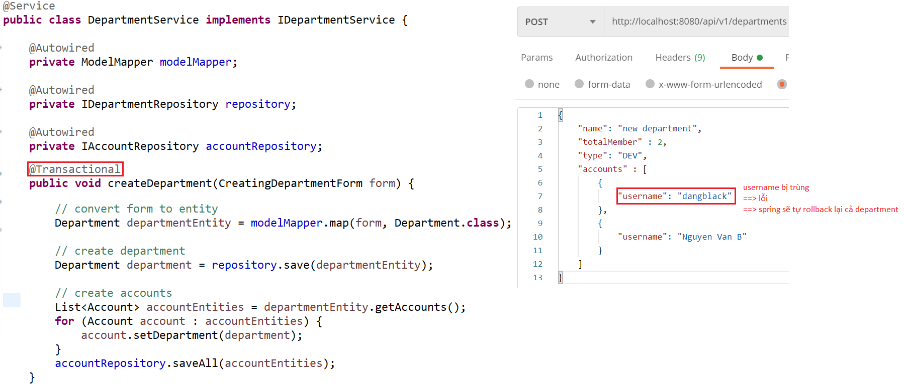
Transaction
Example:

Slide 14
Transaction
Reference: https://www.baeldung.com/transaction-configuration-with-jpa-and-spring

Slide 15
Testing System Assignments
Self-practice

Slide 16
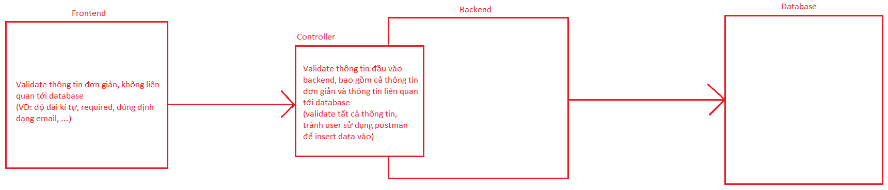
Validate
Bean Validation, Hibernate Validation Libraries
Using for Backend validation

Slide 17
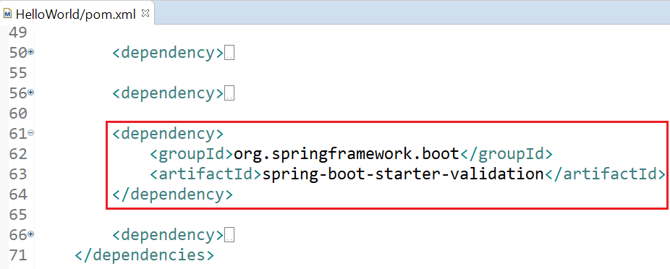
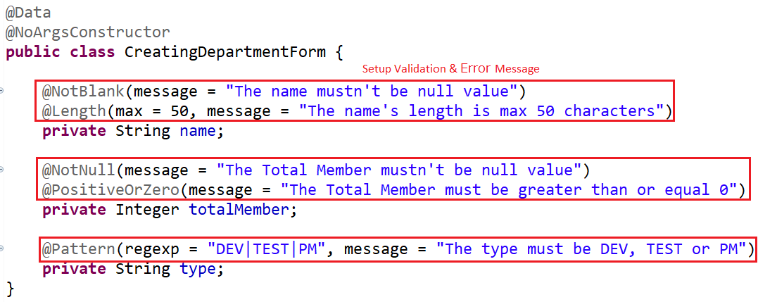
Validate
Example 1:
pom.xml
Form

Slide 18
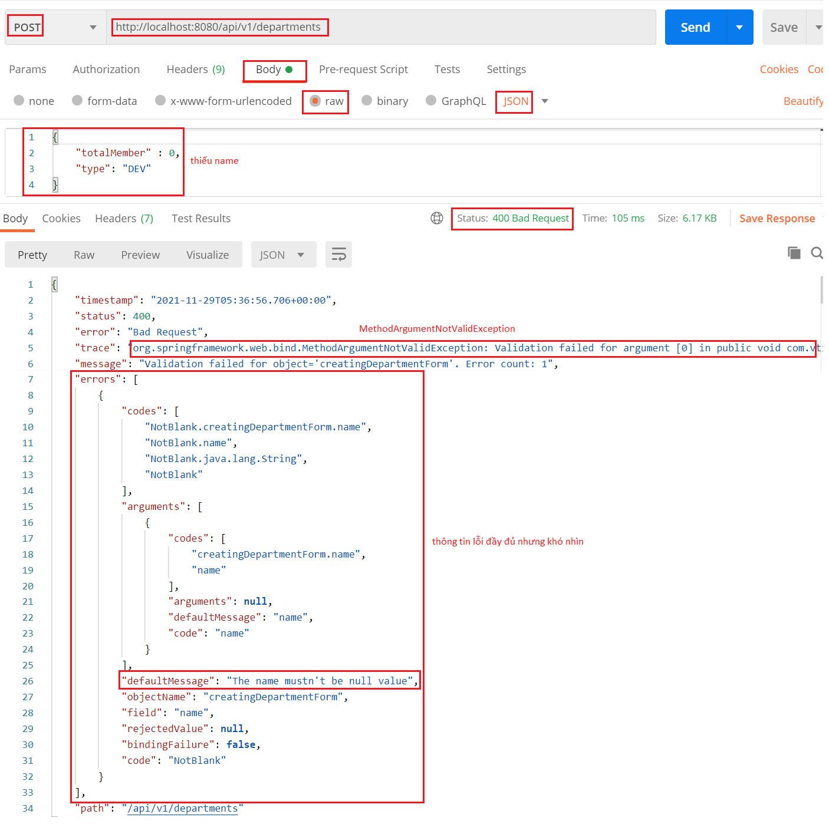
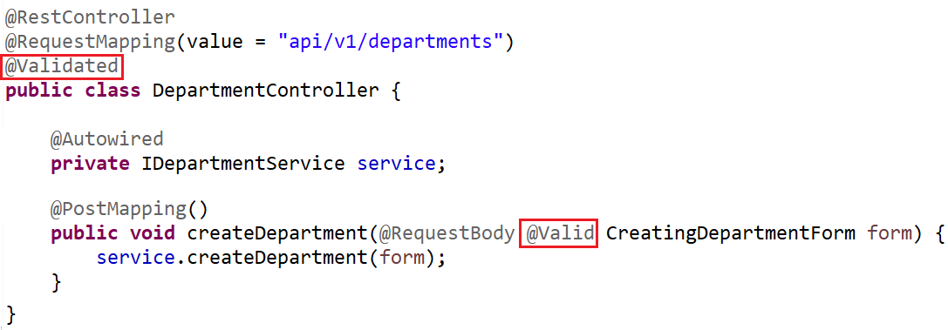
Validate
Controller
Test

Slide 19
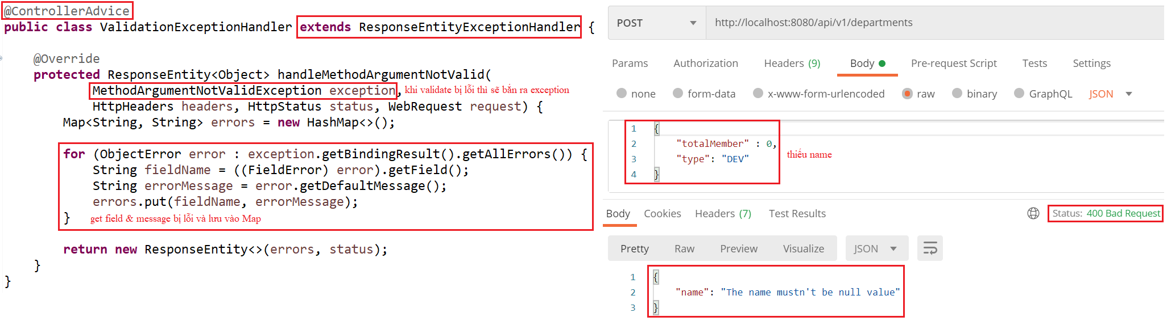
Validate
Example 2: Modify output

Slide 20
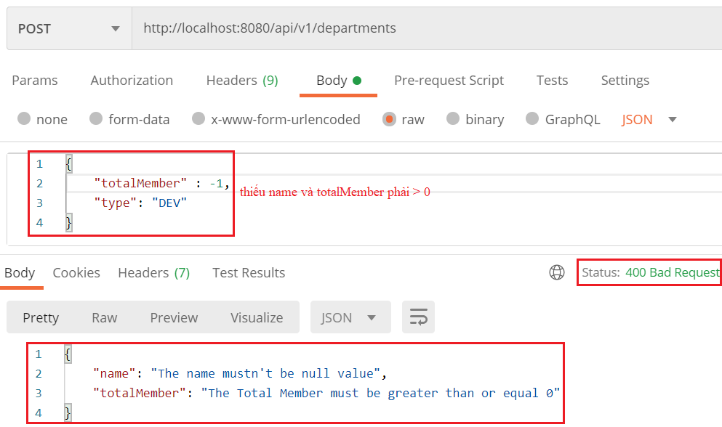
Validate

Slide 21
Testing System Assignments
Self-practice

Slide 22
Validate
Annotation
Annotation | Meaning
@Null @NotNull @NotEmpty @NotBlank | The property must be null The property must not be null The property is not null or empty (applied to String, Collection, Map, Array) The property is not null, empty or whitespace (applied to String)
@Min @Max @Range | The property has a value no smaller than the value attribute
@Positive @PositiveOrZero @Negative @NegativeOrZero | It apply to numeric values and validate that they are strictly positive
@Size @Length @CodePointLength | the annotated property value has a size between the attributes min and max (applied to String, Collection, Map, array) Apply for only String

Slide 23
Validate
@Future @FutureOrPresent @Past @PastOrPresent | A date value is in the future
@DurationMin @DurationMax
@Email @URL @SafeHtml @CreditCardNumber | The property is a valid email address
@UniqueElements | Check a collection does not contain duplicates
@Pattern
https://docs.jboss.org/hibernate/stable/validator/reference/en-US/html_single/#section-builtin-constraints

Slide 24
Testing System Assignments
Self-practice

Slide 25
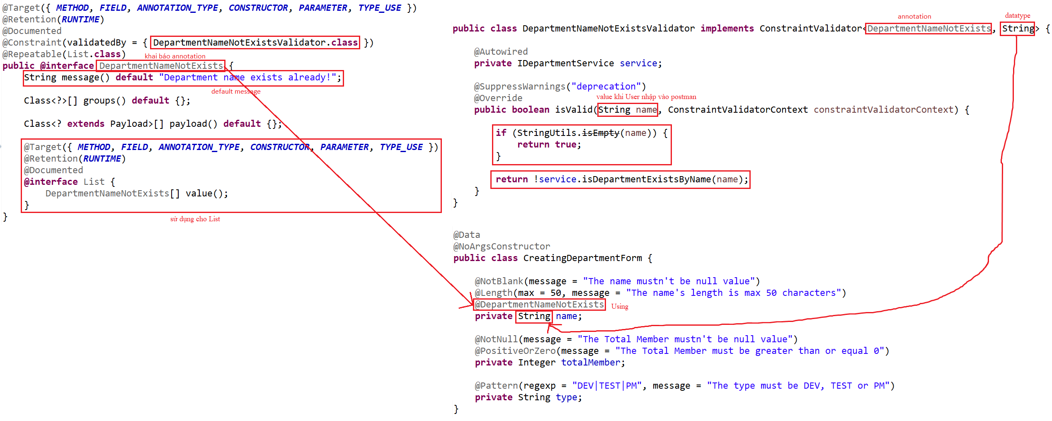
Validate
Example 3: Custom Annotation

Slide 26
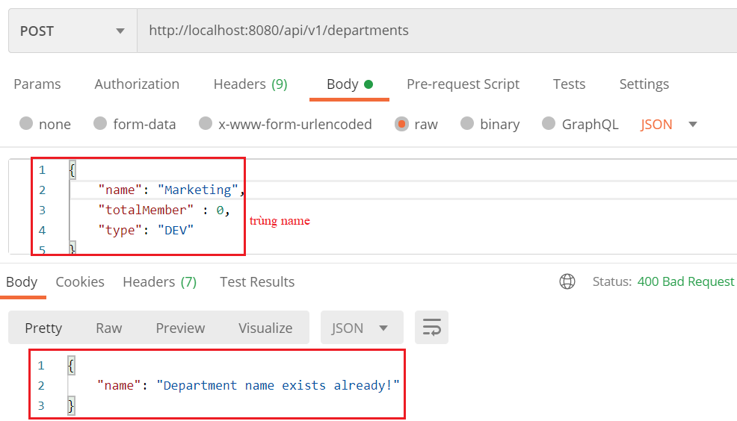
Validate

Slide 27
Testing System Assignments
Self-practice

Slide 28
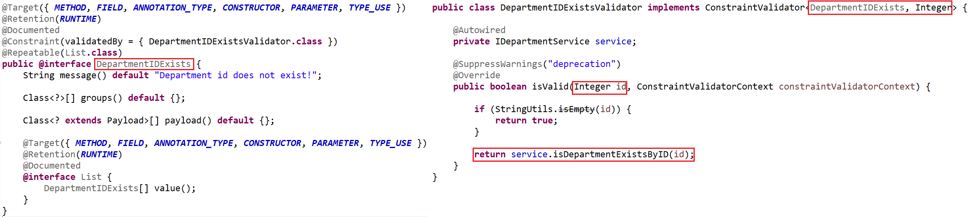
Validate
Example 4: Custom Annotation

Slide 29
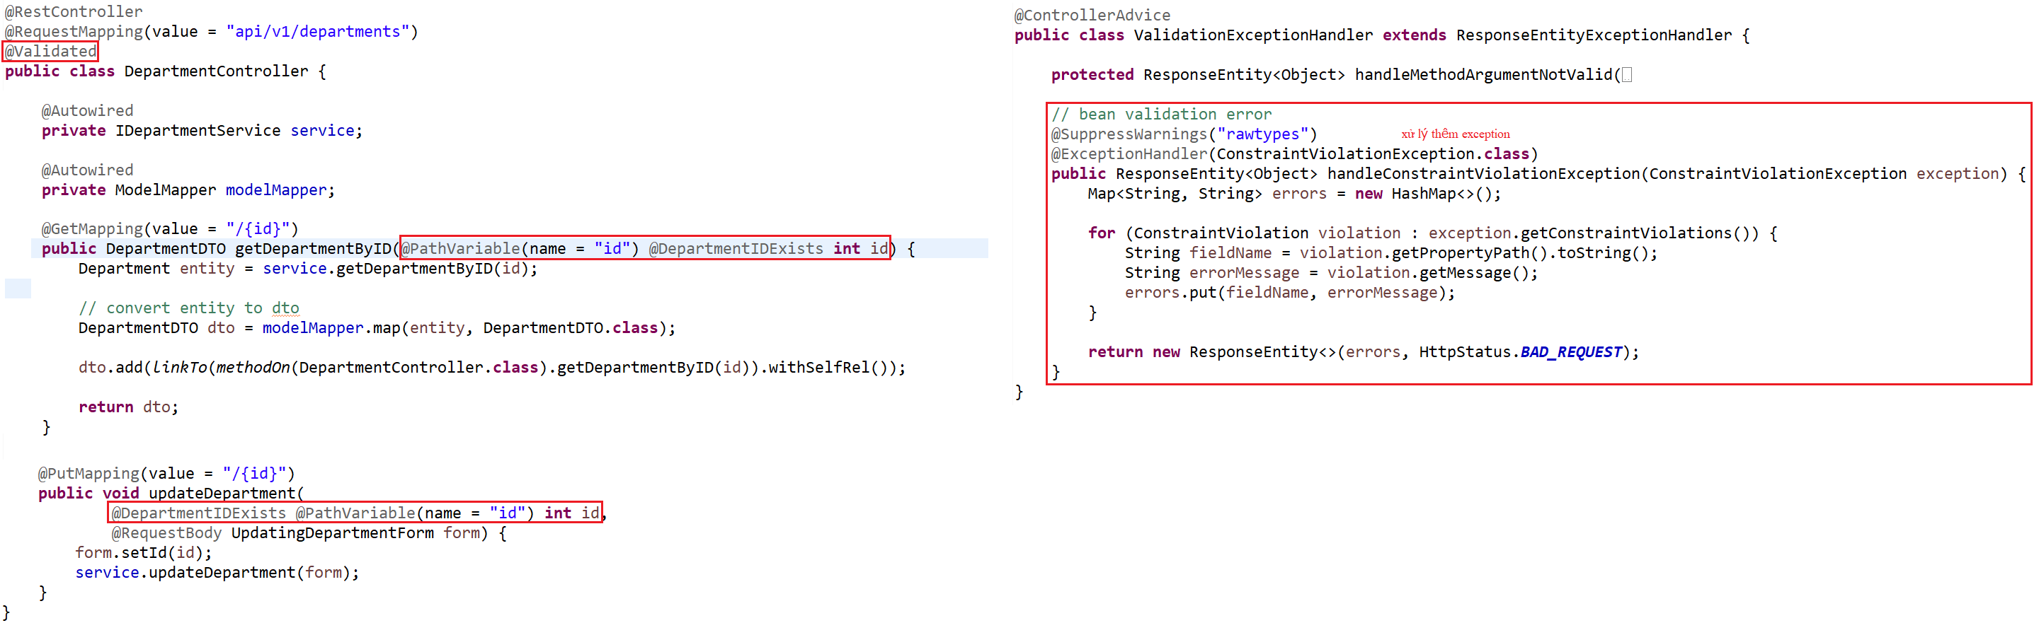
Validate

Slide 30
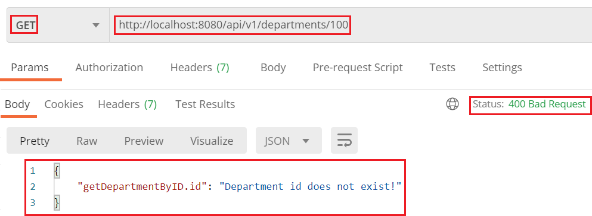
Validate

Slide 31
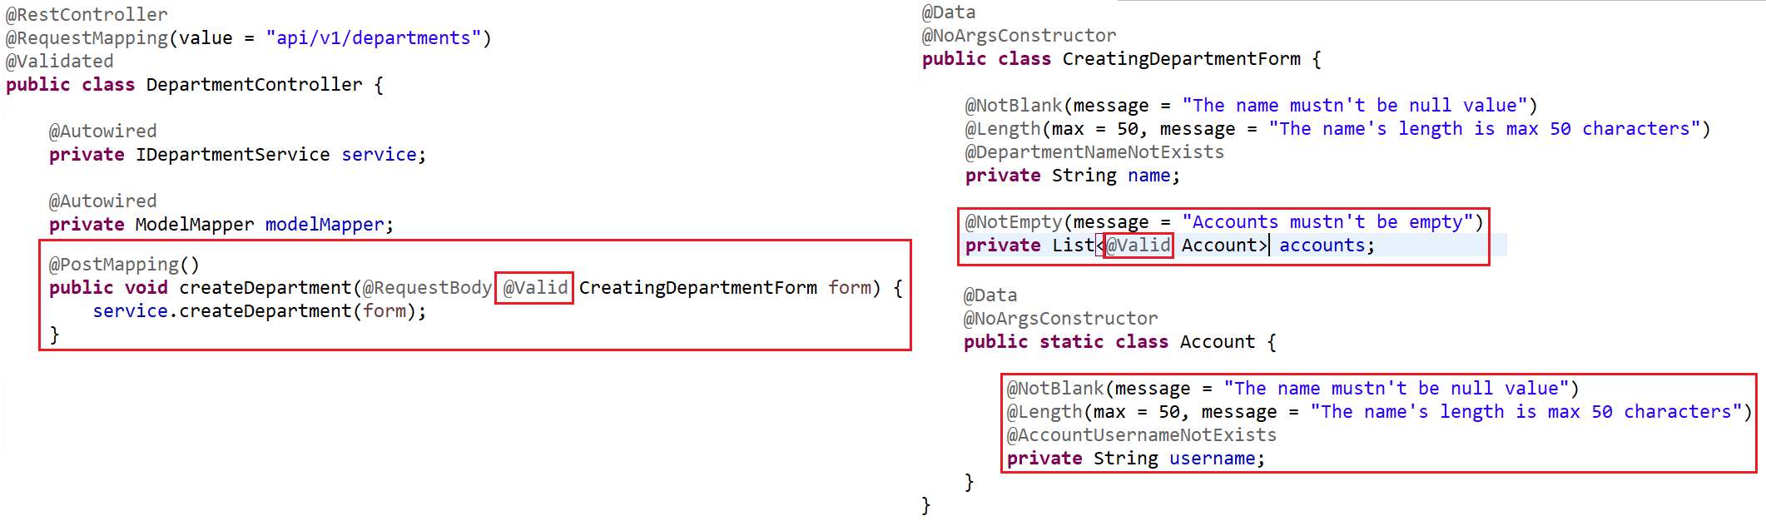
Validate
Example 5: List

Slide 32
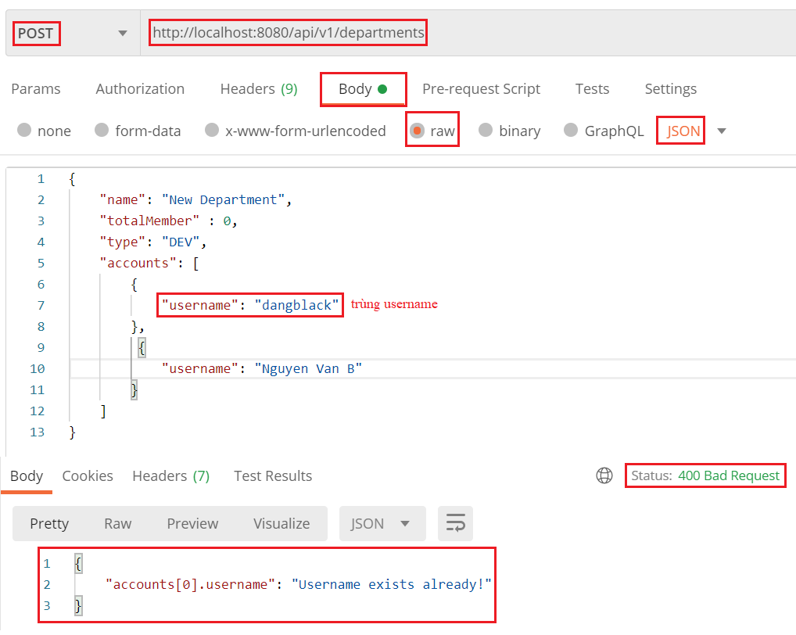
Validate

Slide 33
Testing System Assignments
Self-practice

Slide 34
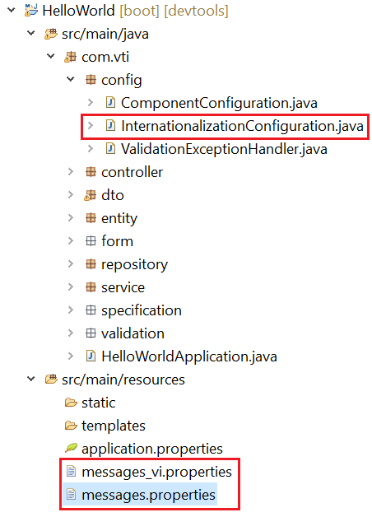
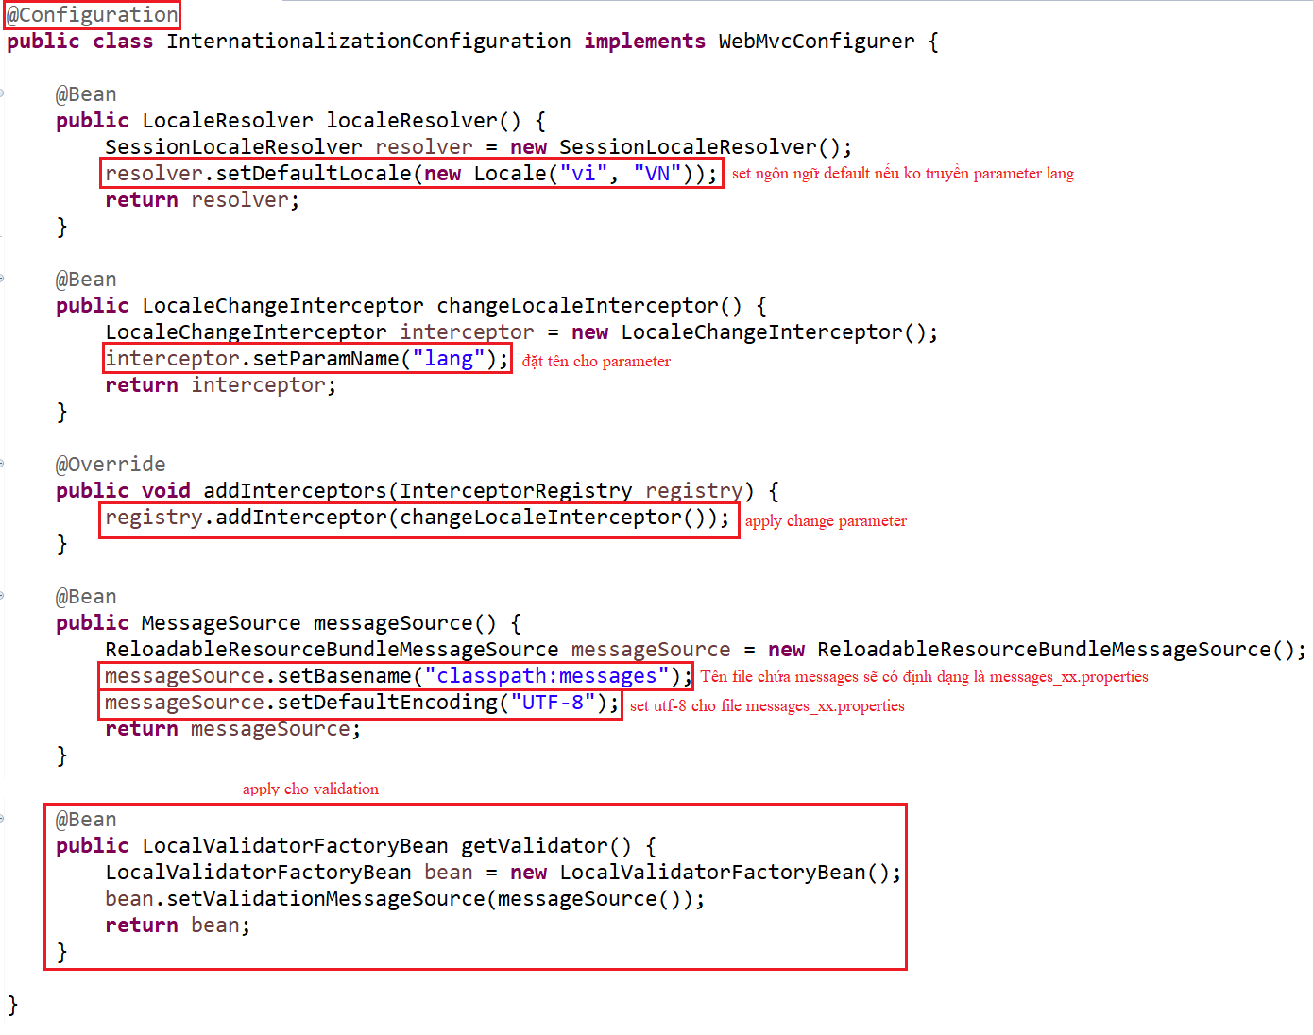
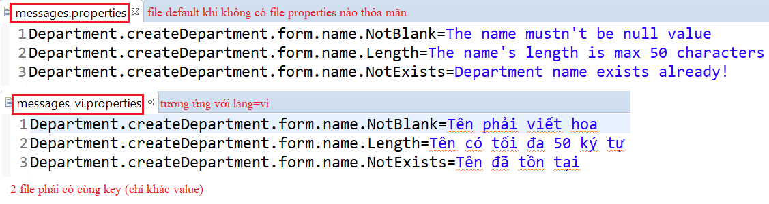
Internationalization
Example 1: Internationalization with Validation

Slide 35
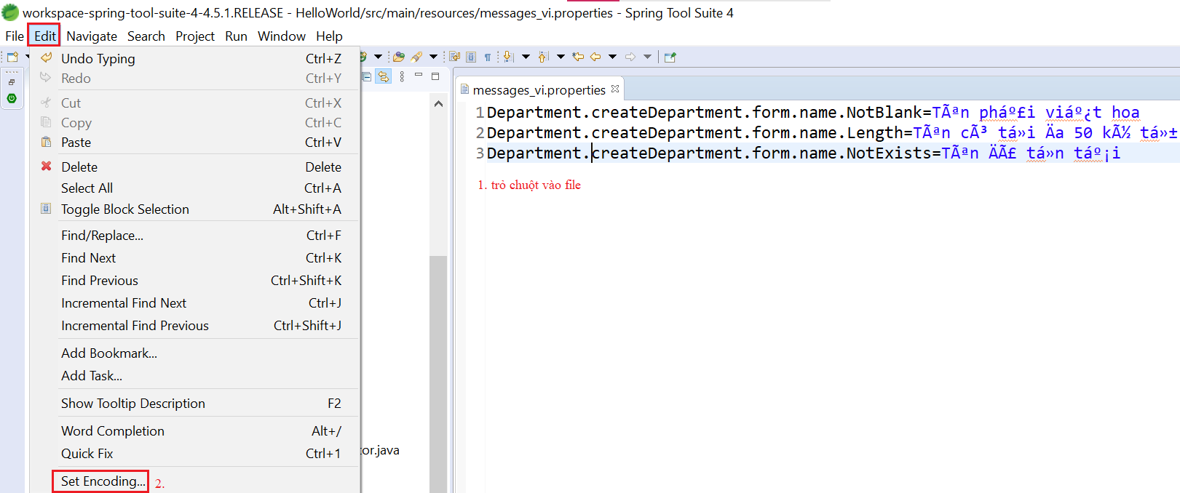
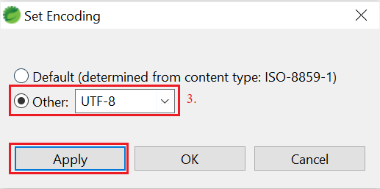
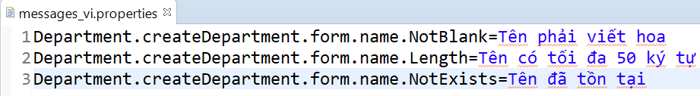
Internationalization
Fix Encoding

Slide 36
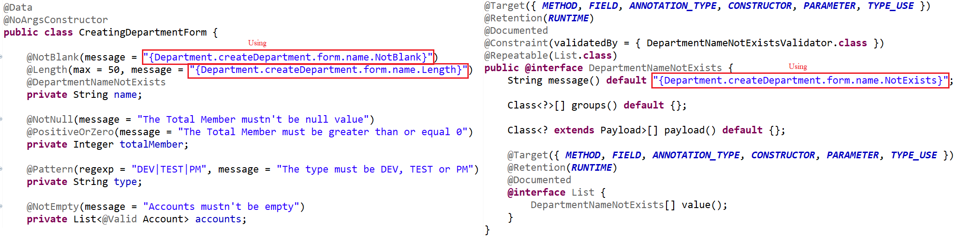
Internationalization
Using

Slide 37
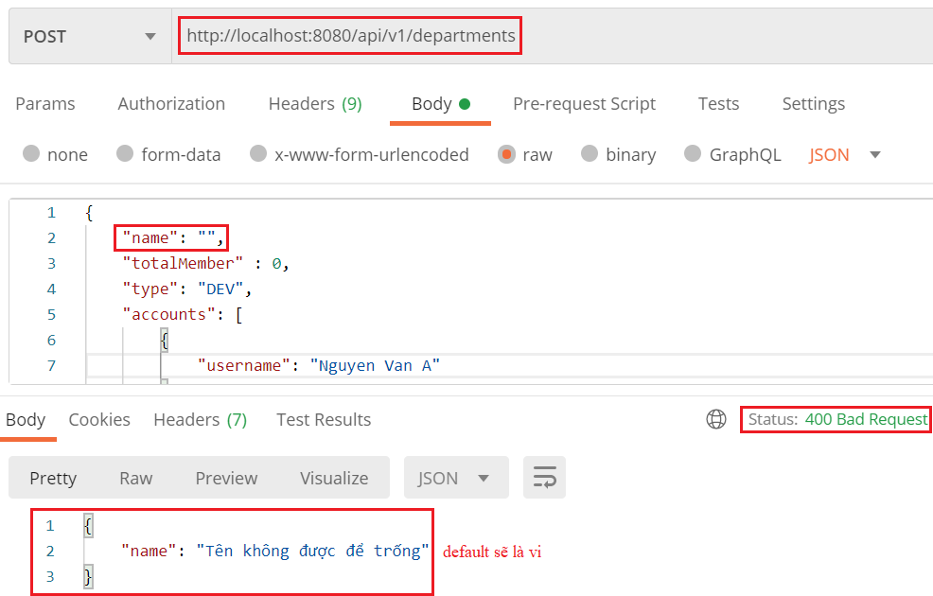
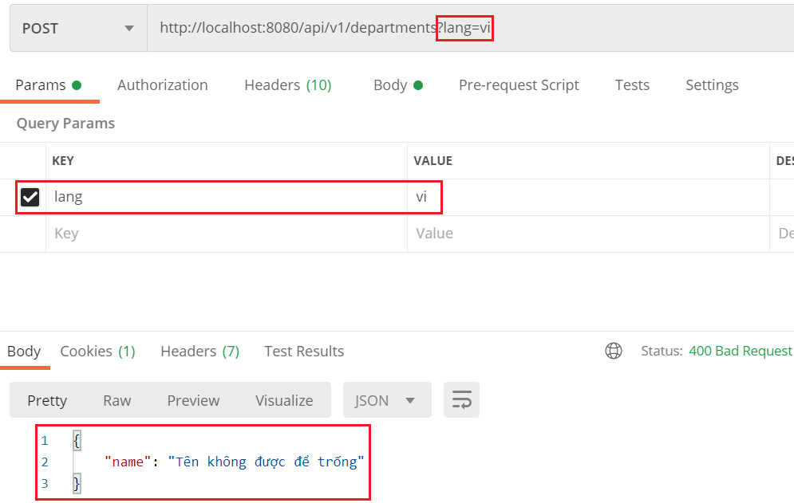
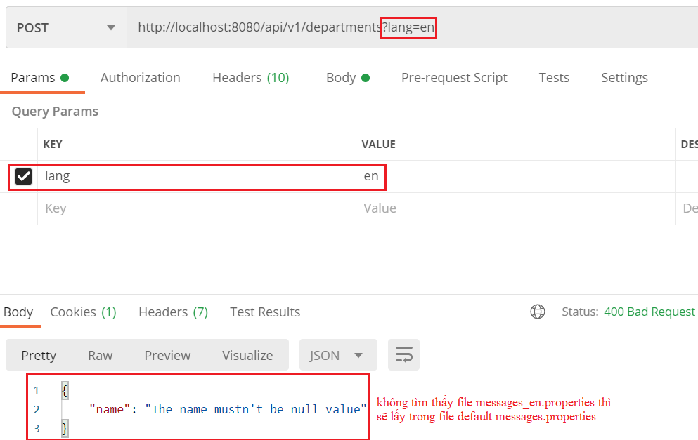
Internationalization
Default & lang=vi
lang=en

Slide 38
Testing System Assignments
Self-practice

Slide 39
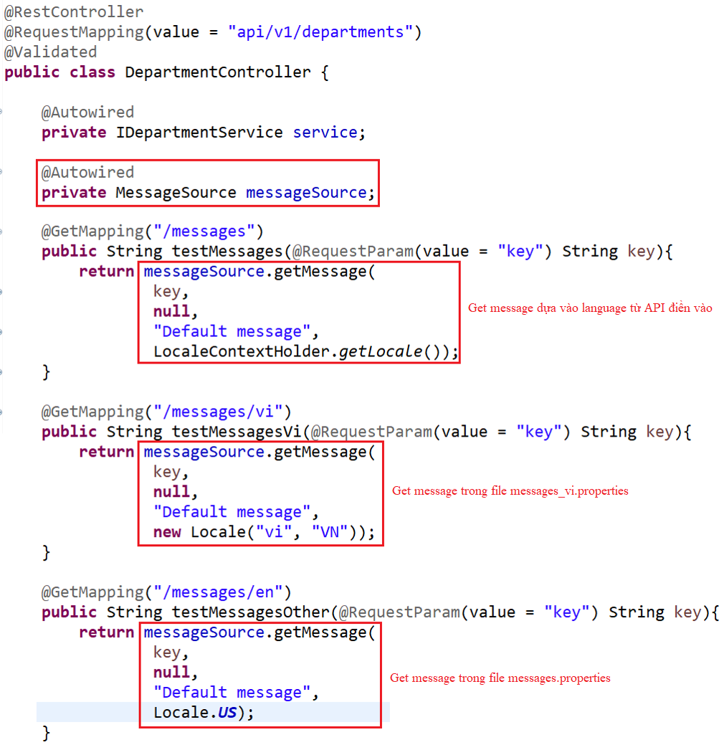
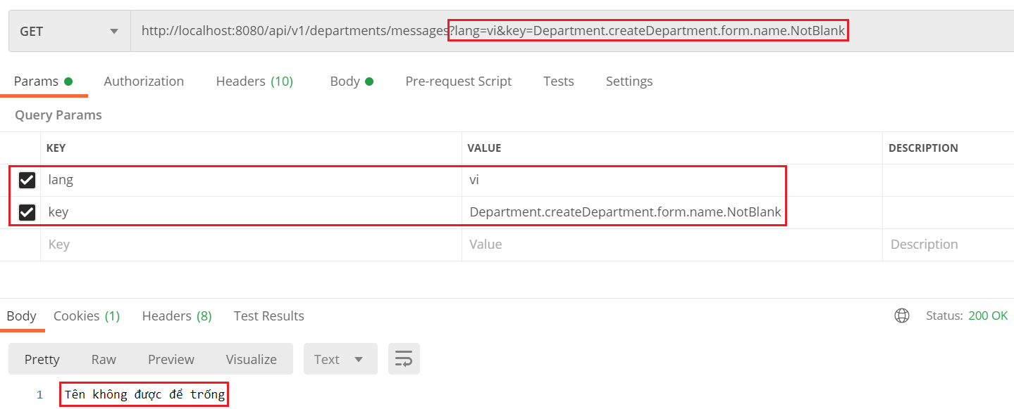
Internationalization
Example 2: Get Message

Slide 40
Testing System Assignments
Self-practice

Slide 41
Other Tools
Swagger
Spring Data Rest

Slide 42
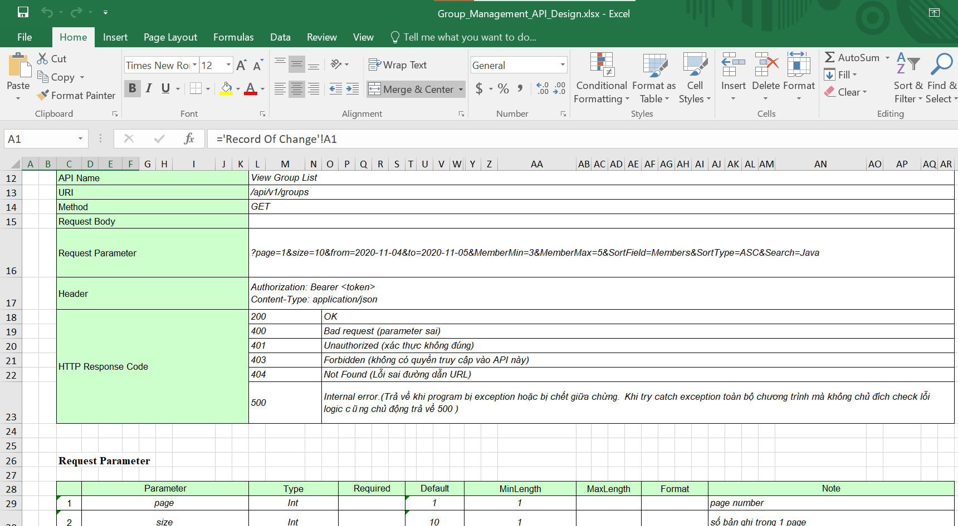
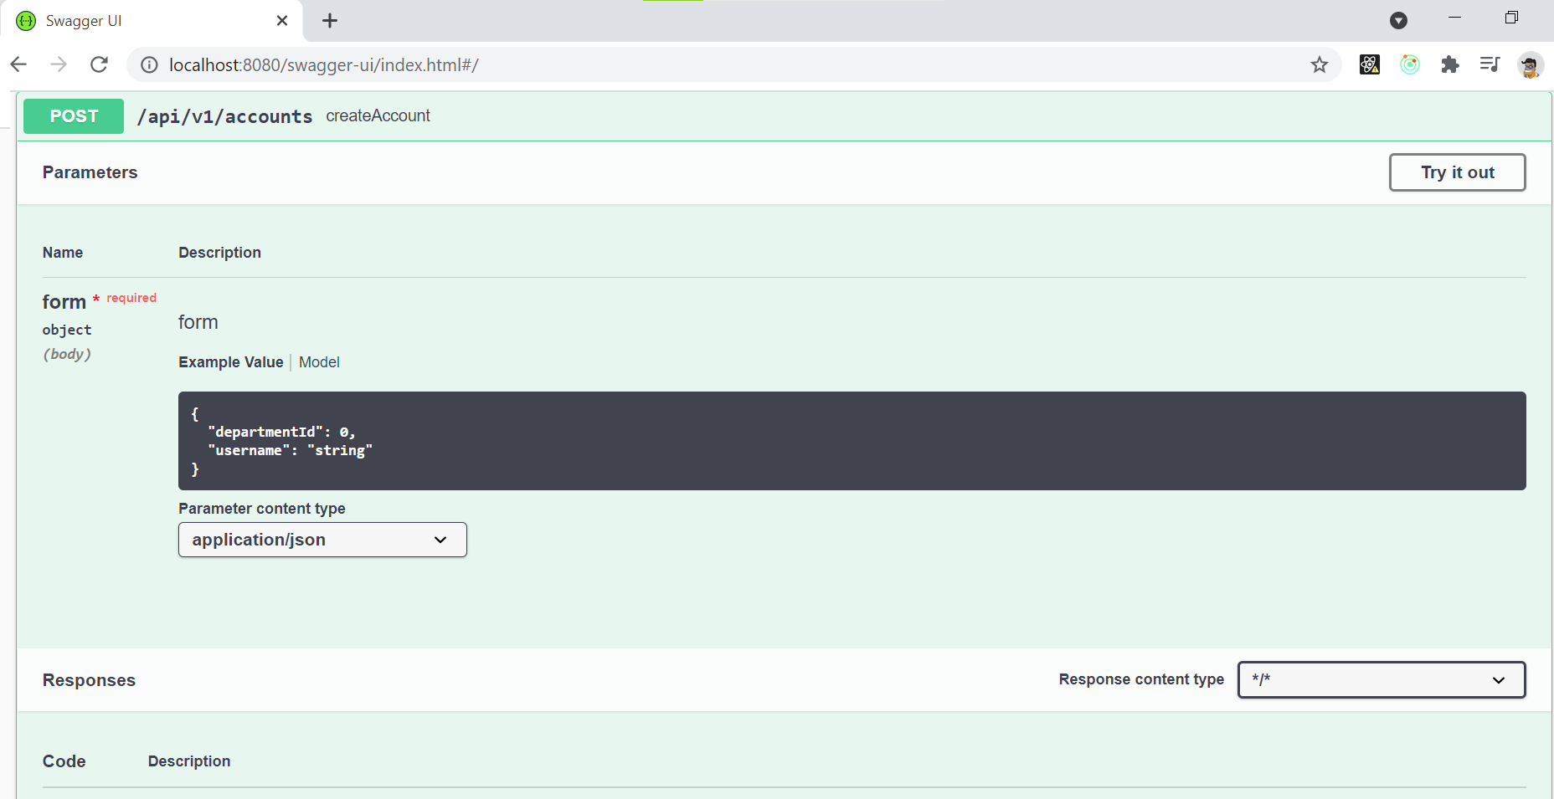
Swagger
Using for creating API document
Integration with Bean Validation, String Data Rest
Other name: Spring fox
API Design (Excel)
Swagger

Slide 43
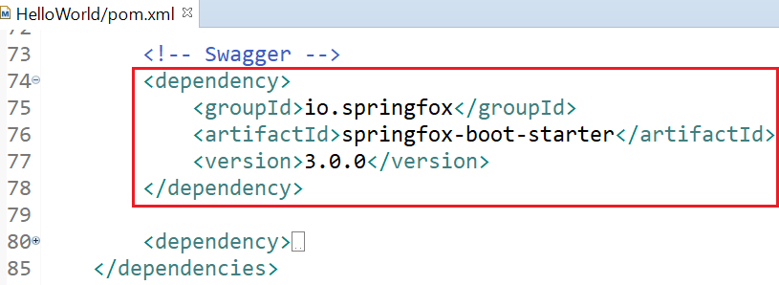
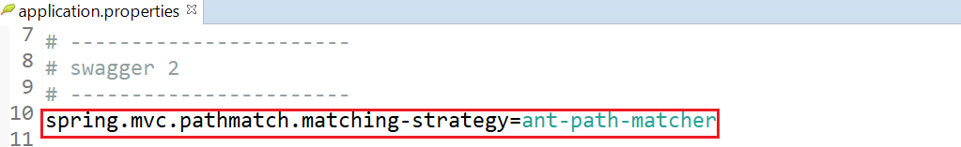
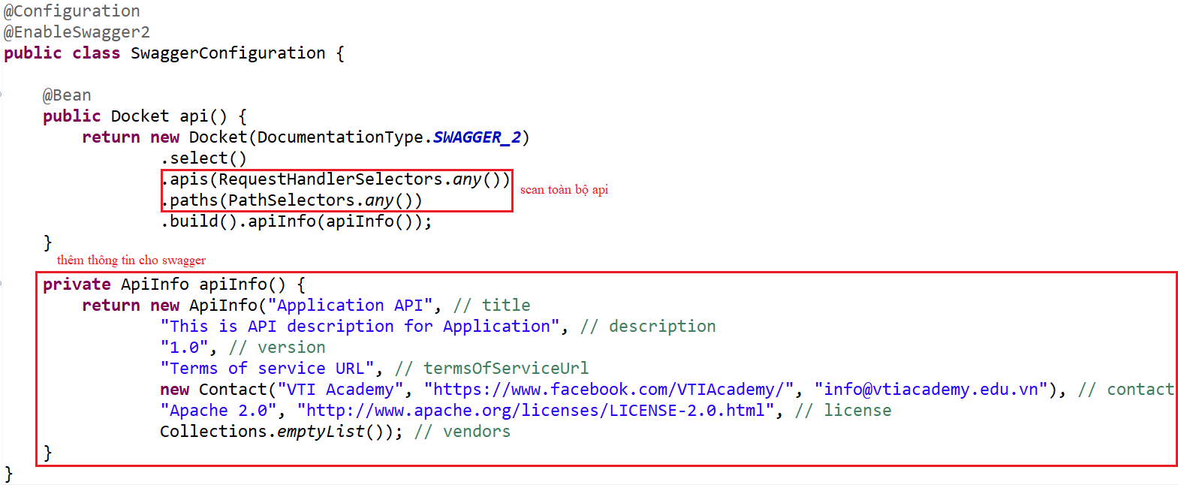
Swagger
Example:
pom.xml
Configuration

Slide 44
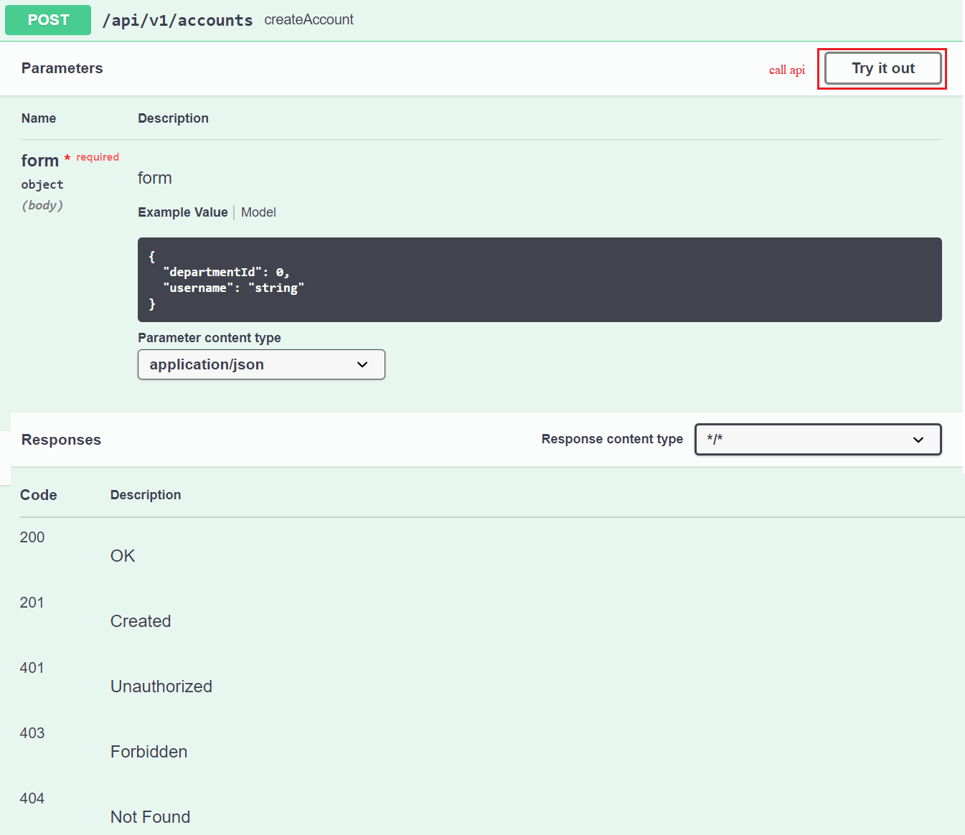
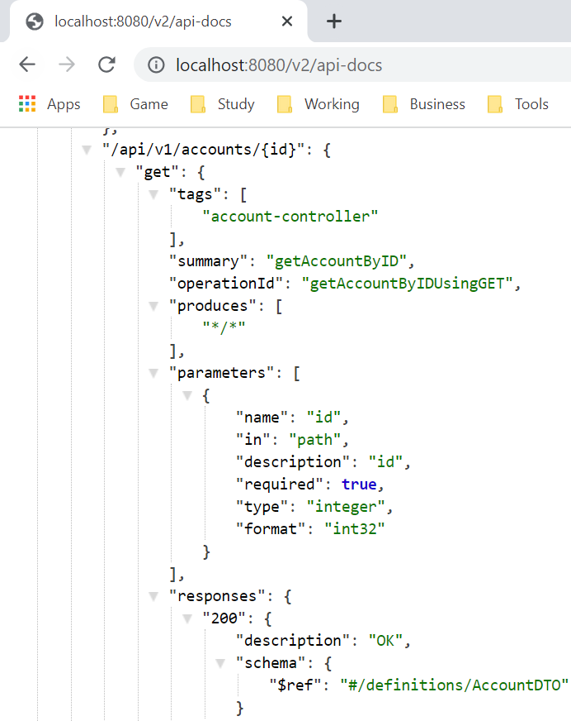
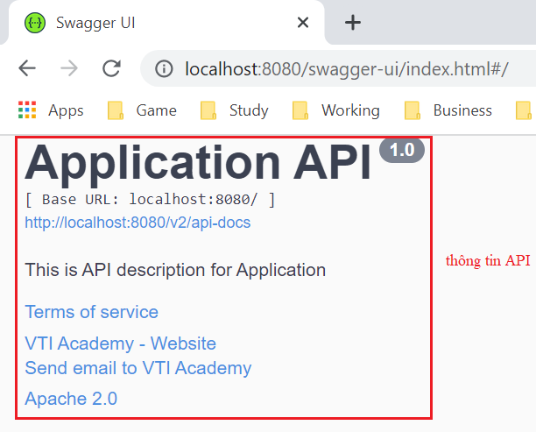
Swagger
http://localhost:8080/swagger-ui/index.html
http://localhost:8080/v2/api-docs

Slide 45
Testing System Assignments
Self-practice

Slide 46
Swagger
Reference: https://www.baeldung.com/swagger-2-documentation-for-spring-rest-api

Slide 47
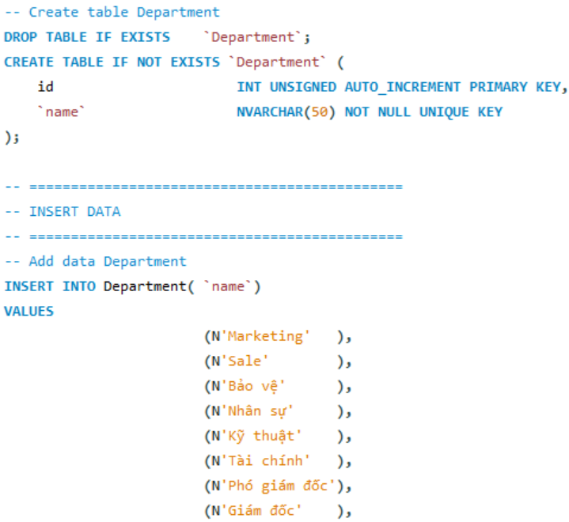
Spring Data Rest
Generate RESTful API based on repositories
Example:
Database

Slide 48
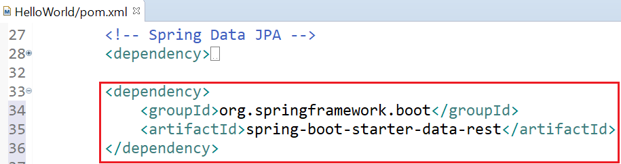
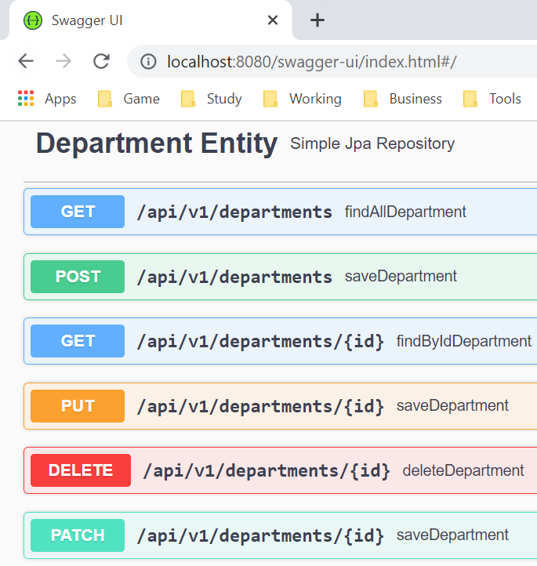
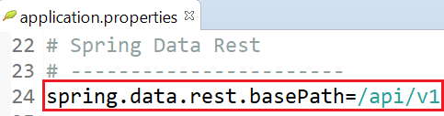
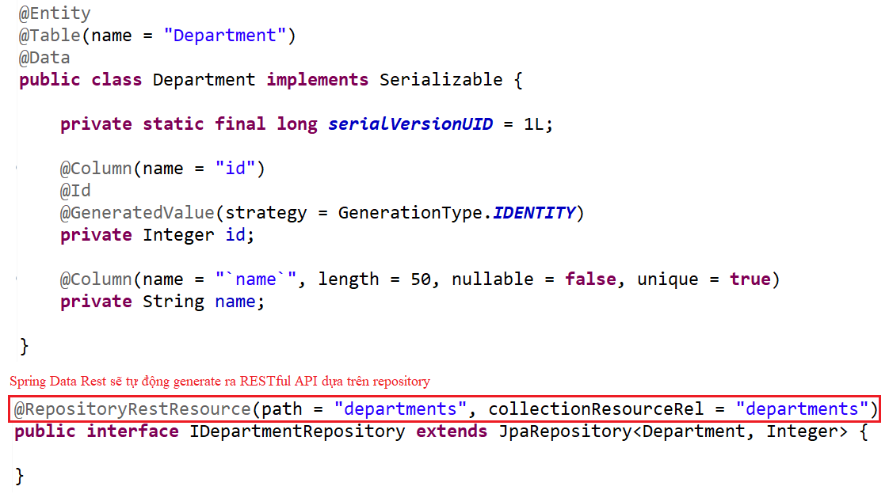
Spring Data Rest
pom.xml
Swagger

Slide 49
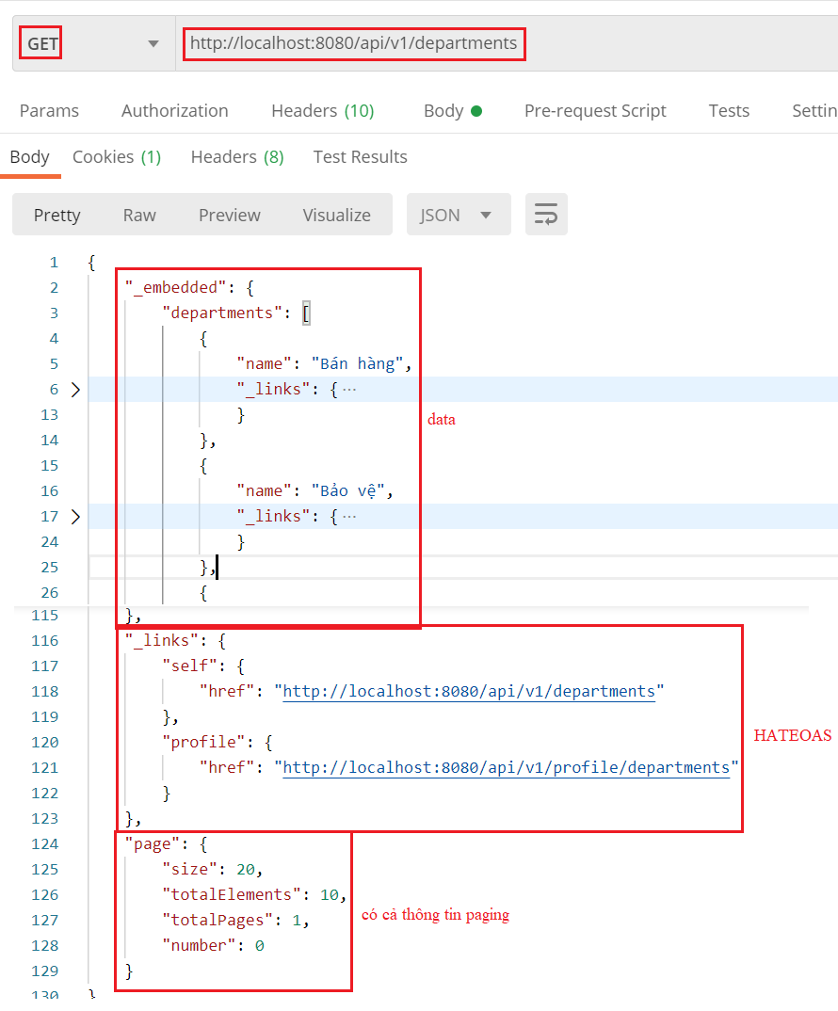
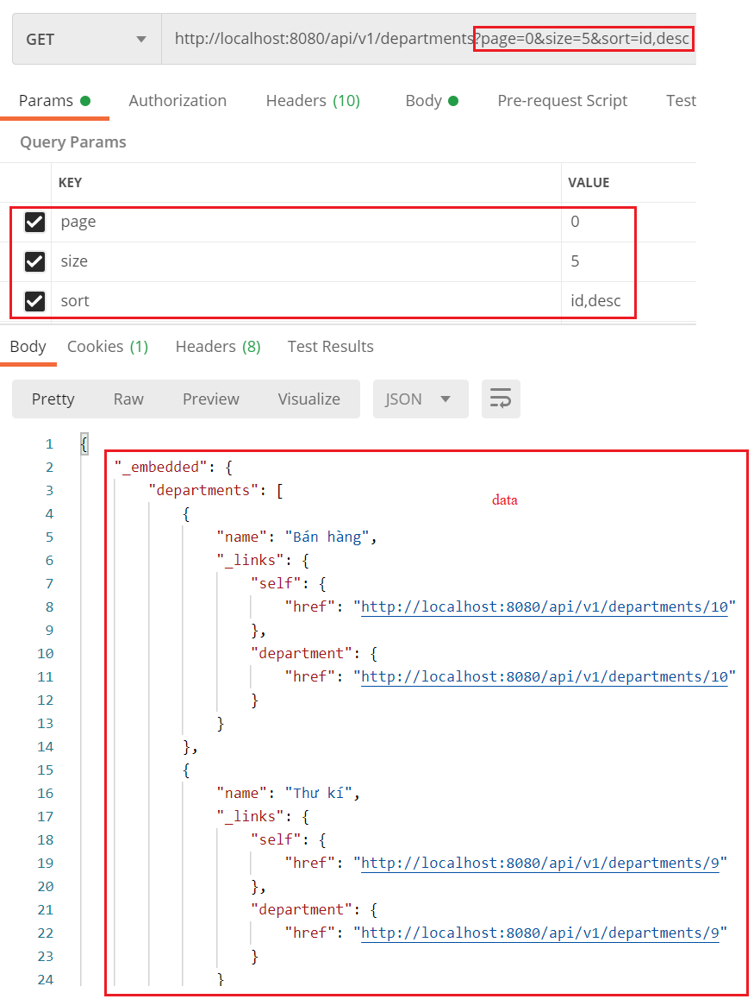
Spring Data Rest
Test

Slide 50
Testing System Assignments
Self-practice

Slide 51
Spring Data Rest
Reference: https://docs.spring.io/spring-data/rest/docs/3.0.2.RELEASE/reference/html/

Slide 52
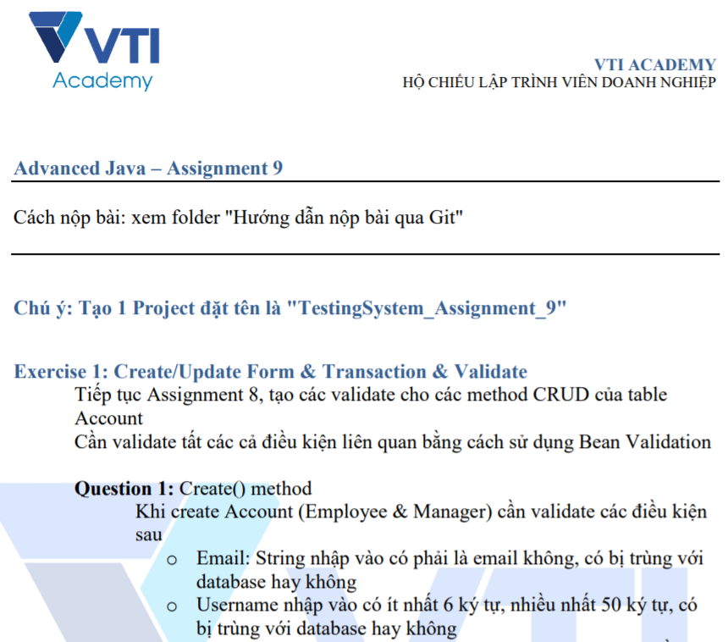
Testing System Assignments

Slide 53
Reference
https://www.baeldung.com
https://spring.io/projects/spring-boot
https://spring.io/guides#getting-started-guides

Slide 54
Q & A
Copyright © VTI Academy All Rights Reserved

